Slide 2
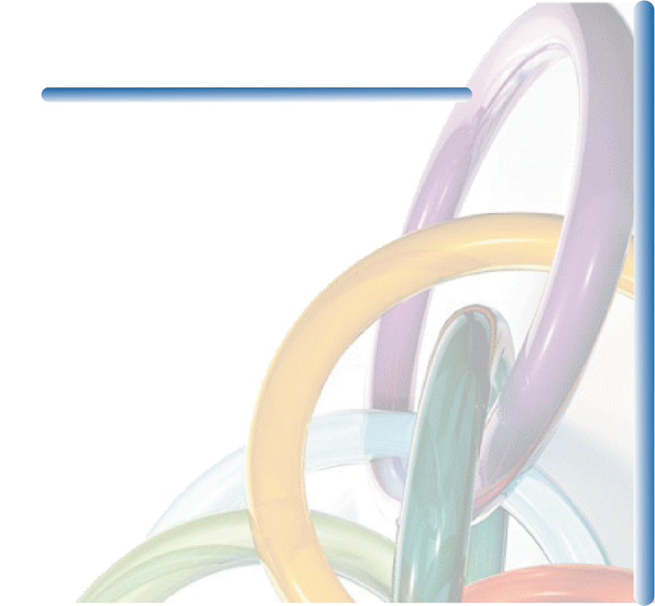
CHAPTER 7 OUTLINE
7.1 Measuring Cost: Which Costs Matter?
7.2 Cost in the Short Run
7.3 Cost in the Long Run
7.4 Long-Run versus Short-Run Cost Curves
7.5 Production with Two Outputs—Economies of Scope
7.6 Dynamic Changes in Costs—The Learning Curve
7.7 Estimating and Predicting Cost

Slide 3

MEASURING COST: WHICH COSTS MATTER?
7.1
Economic Cost versus Accounting Cost
● accounting cost Actual expenses plus depreciation charges for capital equipment.
● economic cost Cost to a firm of utilizing economic resources in production, including opportunity cost.
Opportunity Cost
● opportunity cost Cost associated with opportunities that are forgone when a firm’s resources are not put to their best alternative use.

Slide 4
MEASURING COST: WHICH COSTS MATTER?
7.1
Sunk Costs
● sunk cost Expenditure that has been made and cannot be recovered.
Because a sunk cost cannot be recovered, it should not influence the firm’s decisions.
Because it has no alternative use, its opportunity cost is zero.

Slide 5

MEASURING COST: WHICH COSTS MATTER?
7.1
The Northwestern University Law School has been located in Chicago. However, the main campus is located in the suburb of Evanston.
In the mid-1970s, the law school began planning the construction of a new building and needed to decide on an appropriate location. Should it be built on the current site, near downtown Chicago law firms? Should it be moved to Evanston, physically integrated with the rest of the university?
Some argued it was cost-effective to locate the new building in the city because the university already owned the land. Land would have to be purchased in Evanston if the building were to be built there.
Does this argument make economic sense?
No. It makes the common mistake of failing to appreciate opportunity costs. From an economic point of view, it is very expensive to locate downtown because the property could have been sold for enough money to buy the Evanston land with substantial funds left over.
Northwestern decided to keep the law school in Chicago.

Slide 6
MEASURING COST: WHICH COSTS MATTER?
7.1
Fixed Costs and Variable Costs
● total cost (TC or C) Total economic cost of production, consisting of fixed and variable costs.
● fixed cost (FC) Cost that does not vary with the level of output and that can be eliminated only by shutting down.
● variable cost (VC) Cost that varies as output varies.
The only way that a firm can eliminate its fixed costs is by shutting down.

Slide 7
MEASURING COST: WHICH COSTS MATTER?
7.1
Fixed Costs and Variable Costs
Shutting Down
Shutting down doesn’t necessarily mean going out of business.
By reducing the output of that factory to zero, the company could eliminate the costs of raw materials and much of the labor. The only way to eliminate fixed costs would be to close the doors, turn off the electricity, and perhaps even sell off or scrap the machinery.
Fixed or Variable?
How do we know which costs are fixed and which are variable?
Over a very short time horizon—say, a few months—most costs are fixed. Over such a short period, a firm is usually obligated to pay for contracted shipments of materials.
Over a very long time horizon—say, ten years—nearly all costs are variable. Workers and managers can be laid off (or employment can be reduced by attrition), and much of the machinery can be sold off or not replaced as it becomes obsolete and is scrapped.

Slide 8
MEASURING COST: WHICH COSTS MATTER?
7.1
Fixed versus Sunk Costs
Sunk costs are costs that have been incurred and cannot be recovered.
An example is the cost of R&D to a pharmaceutical company to develop and test a new drug and then, if the drug has been proven to be safe and effective, the cost of marketing it.
Whether the drug is a success or a failure, these costs cannot be recovered and thus are sunk.
Amortizing Sunk Costs
● amortization Policy of treating a one-time expenditure as an annual cost spread out over some number of years.

Slide 9

MEASURING COST: WHICH COSTS MATTER?
7.1
It is important to understand the characteristics of production costs and to be able to identify which costs are fixed, which are variable, and which are sunk.
Good examples include the personal computer industry (where most costs are variable), the computer software industry (where most costs are sunk), and the pizzeria business (where most costs are fixed).
Because computers are very similar, competition is intense, and profitability depends on the ability to keep costs down. Most important are the cost of components and labor.
A software firm will spend a large amount of money to develop a new application. The company can recoup its investment by selling as many copies of the program as possible.
For the pizzeria, sunk costs are fairly low because equipment can be resold if the pizzeria goes out of business. Variable costs are low—mainly the ingredients for pizza and perhaps wages for a workers to produce and deliver pizzas.

Slide 10

MEASURING COST: WHICH COSTS MATTER?
7.1
Marginal and Average Cost
Marginal Cost (MC)
● marginal cost (MC) Increase in cost resulting from the production of one extra unit of output.
Because fixed cost does not change as the firm’s level of output changes, marginal cost is equal to the increase in variable cost or the increase in total cost that results from an extra unit of output.
We can therefore write marginal cost as

Slide 11
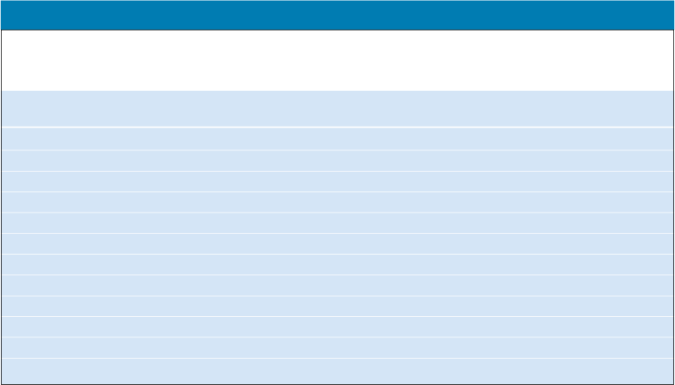
MEASURING COST: WHICH COSTS MATTER?
7.1
Marginal and Average Cost
Marginal Cost (MC)
TABLE 7.1 A Firm’s Costs
Rate of Fixed Variable Total Marginal Average Average Average
Output Cost Cost Cost Cost Fixed Cost Variable Cost Total Cost
(Units (Dollars (Dollars (Dollars (Dollars (Dollars (Dollars (Dollars
per Year) per Year) per Year) per Year) per Unit) per Unit) per Unit) per Unit)
(FC) (VC) (TC) (MC) (AFC) (AVC) (ATC)
(1) (2) (3) (4) (5) (6) (7)
  0 50 0 50 -- -- -- --
  1 50 50 100 50 50 50 100
  2 50 78 128 28 25 39 64
  3 50 98 148 20 16.7 32.7 49.3
  4 50 112 162 14 12.5 28 40.5
  5 50 130 180 18 10 26 36
  6 50 150 200 20 8.3 25 33.3
  7 50 175 225 25 7.1 25 32.1
  8 50 204 254 29 6.3 25.5 31.8
  9 50 242 292 38 5.6 26.9 32.4
  10 50 300 350 58 5 30 35
  11 50 385 435 85 4.5 35 39.5

Slide 12
MEASURING COST: WHICH COSTS MATTER?
7.1
Marginal and Average Cost
Average Total Cost (ATC)
● average total cost (ATC) Firm’s total cost divided by its level of output.
● average fixed cost (AFC) Fixed cost divided by the level of output.
● average variable cost (AVC) Variable cost divided by the level of output.

Slide 13


COST IN THE SHORT RUN
7.2
The Determinants of Short-Run Cost
The change in variable cost is the per-unit cost of the extra labor w times the amount of extra labor needed to produce the extra output ΔL. Because ΔVC = wΔL, it follows that
The extra labor needed to obtain an extra unit of output is ΔL/Δq = 1/MP_{L}. As a result,
(7.1)
Diminishing Marginal Returns and Marginal Cost
Diminishing marginal returns means that the marginal product of labor declines as the quantity of labor employed increases.
As a result, when there are diminishing marginal returns, marginal cost will increase as output increases.

Slide 14

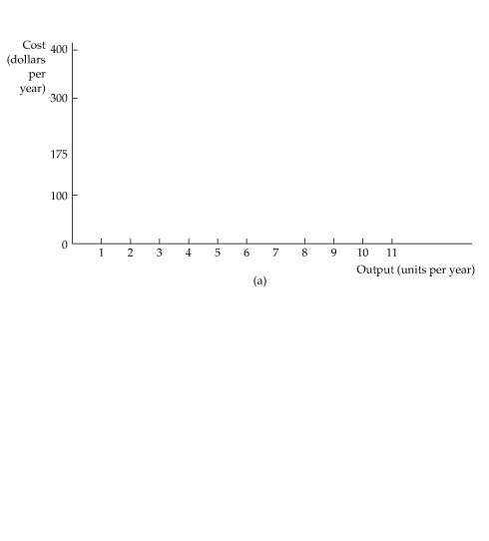


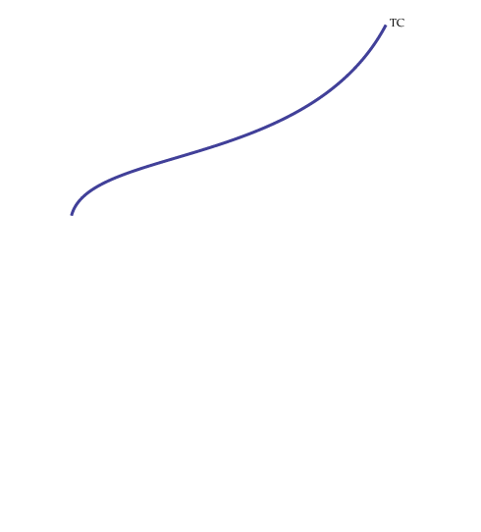
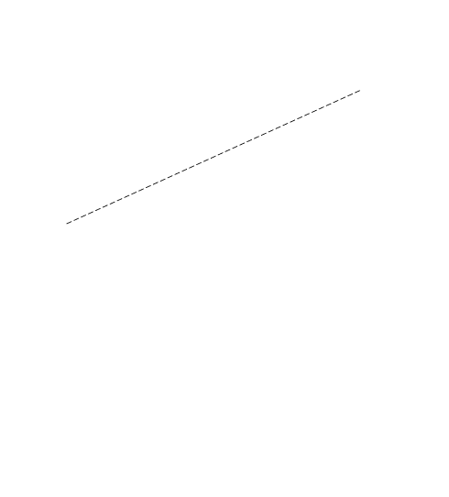
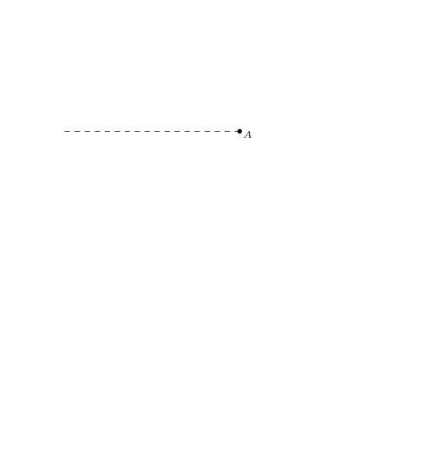
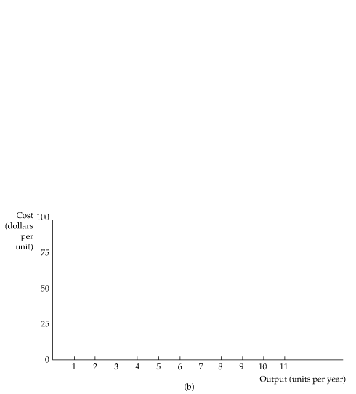

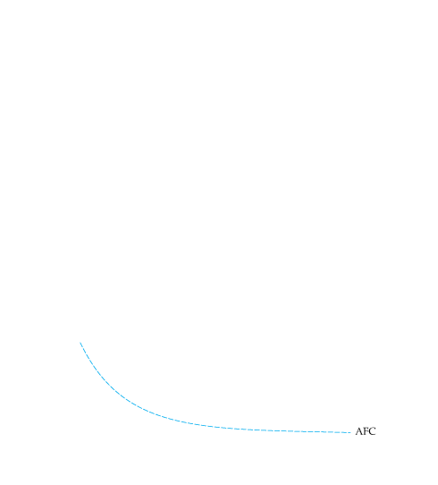
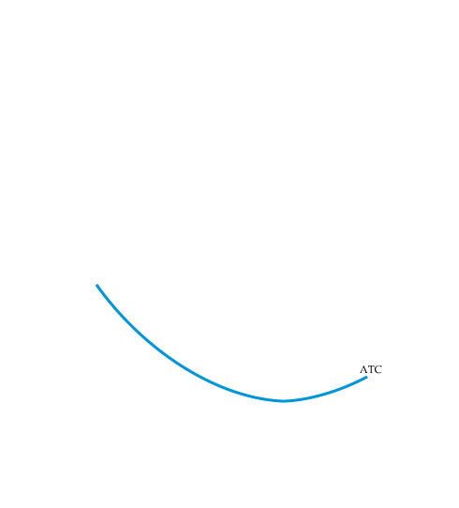
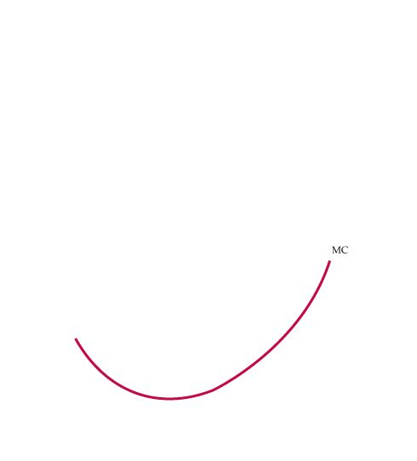

COST IN THE SHORT RUN
7.2
The Shapes of the Cost Curves
Figure 7.1
Cost Curves for a Firm
In (a) total cost TC is the vertical sum of fixed cost FC and variable cost VC.
In (b) average total cost ATC is the sum of average variable cost AVC and average fixed cost AFC.
Marginal cost MC crosses the average variable cost and average total cost curves at their minimum points.

Slide 15
COST IN THE SHORT RUN
7.2
The Shapes of the Cost Curves
The Average-Marginal Relationship
Marginal and average costs are another example of the average-marginal relationship with respect to marginal and average product.
Total Cost as a Flow
Total cost is a flow—for example, some number of dollars per year. For simplicity, we will often drop the time reference, and refer to total cost in dollars and output in units.

Slide 16


COST IN THE SHORT RUN
7.2
TABLE 7.2
Operating Costs for Aluminum Smelting ($/ton) (based on an output of 600 tons/day)
Variable costs that are constant Output ≤ 600 Output > 600
for all output levels tons/day tons/day
Electricity $316 $316
Alumina 369 369
Other raw materials 125 125
Plant power and fuel 10 10
Subtotal $820 $820
Variable costs that increase when
output exceeds 600 tons/day
Labor $150 $225
Maintenance 120 180
Freight 50 75
Subtotal $320 $480
Total operating costs $1140 $1300

Slide 17

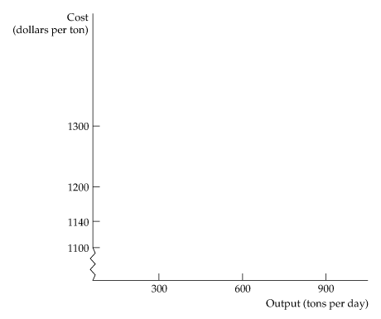
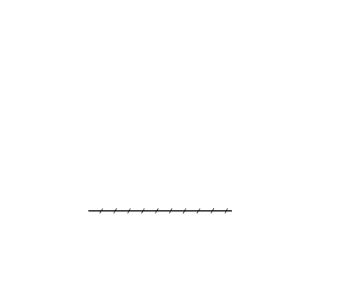
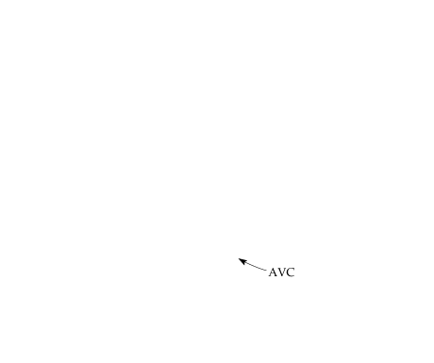
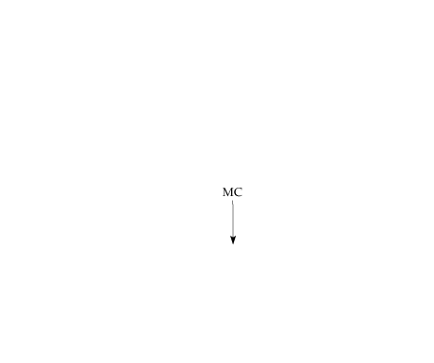

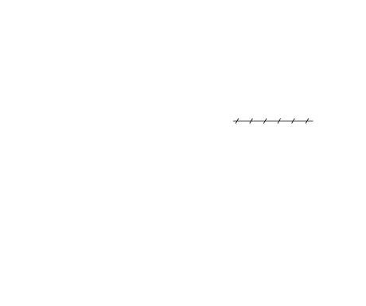

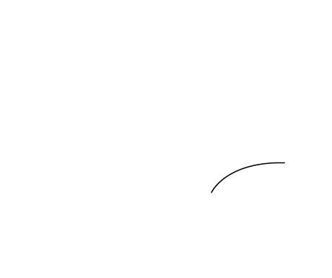
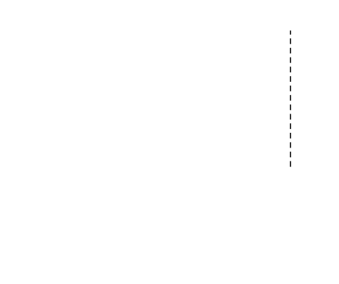
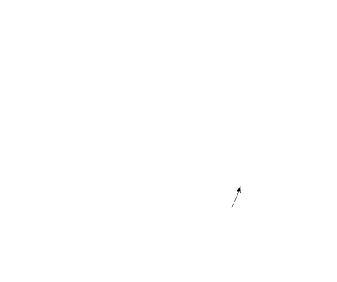
COST IN THE SHORT RUN
7.2
Figure 7.2
The Short-Run Variable Costs of Aluminum Smelting
The short-run average variable cost of smelting is constant for output levels using up to two labor shifts.
When a third shift is added, marginal cost and average variable cost increase until maximum capacity is reached.

Slide 18
COST IN THE LONG RUN
7.3
The User Cost of Capital
● user cost of capital Annual cost of owning and using a capital asset, equal to economic depreciation plus forgone interest.
The user cost of capital is given by the sum of the economic depreciation and the interest (i.e., the financial return) that could have been earned had the money been invested elsewhere. Formally,
We can also express the user cost of capital as a rate per dollar of capital:

Slide 19
COST IN THE LONG RUN
7.3
The Cost-Minimizing Input Choice
We now turn to a fundamental problem that all firms face: how to select inputs to produce a given output at minimum cost.
For simplicity, we will work with two variable inputs: labor (measured in hours of work per year) and capital (measured in hours of use of machinery per year).
The Price of Capital
The price of capital is its user cost, given by r = Depreciation rate + Interest rate.
The Rental Rate of Capital
● rental rate Cost per year of renting one unit of capital.
If the capital market is competitive, the rental rate should be equal to the user cost, r. Why? Firms that own capital expect to earn a competitive return when they rent it. This competitive return is the user cost of capital.
Capital that is purchased can be treated as though it were rented at a rental rate equal to the user cost of capital.

Slide 20
COST IN THE LONG RUN
7.3
The Isocost Line
● isocost line Graph showing all possible combinations of labor and capital that can be purchased for a given total cost.
To see what an isocost line looks like, recall that the total cost C of producing any particular output is given by the sum of the firm’s labor cost wL and its capital cost rK:
(7.2)

Slide 21
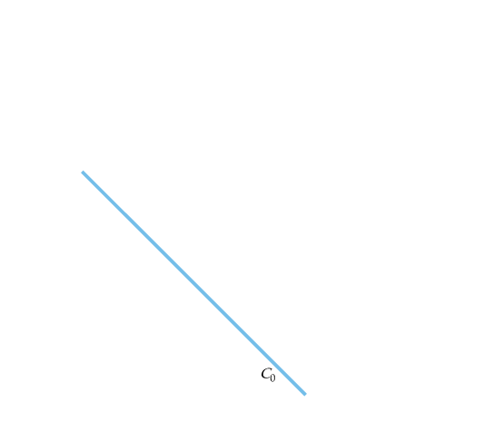
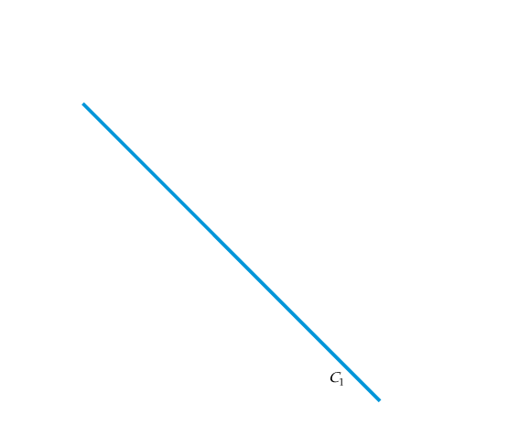
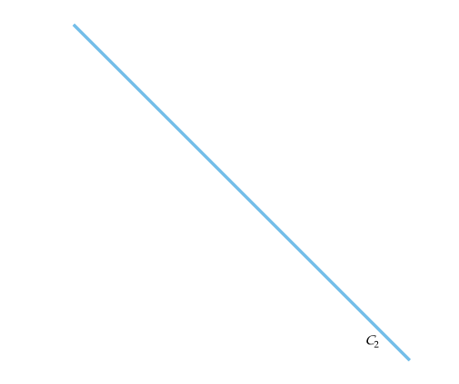
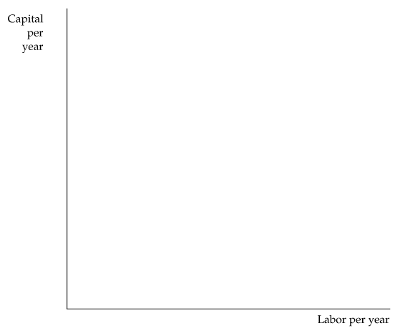
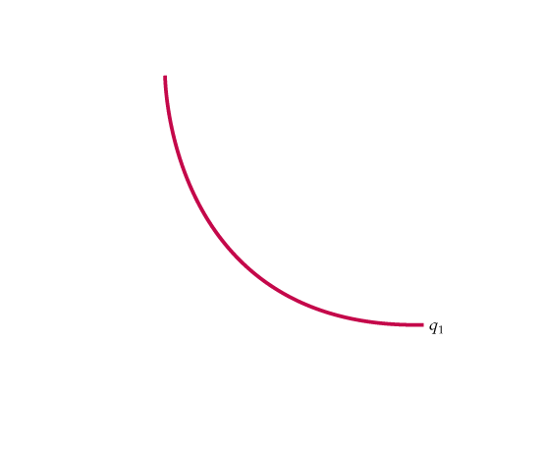
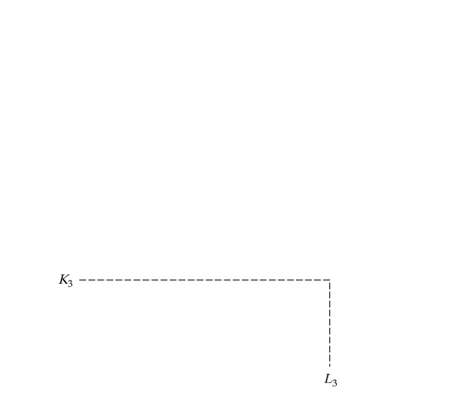
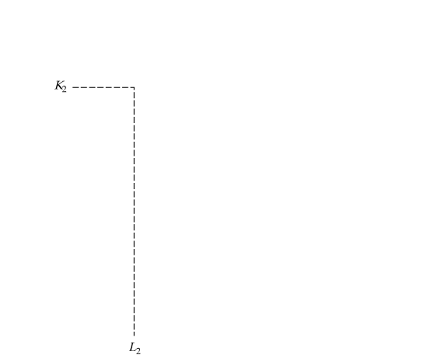
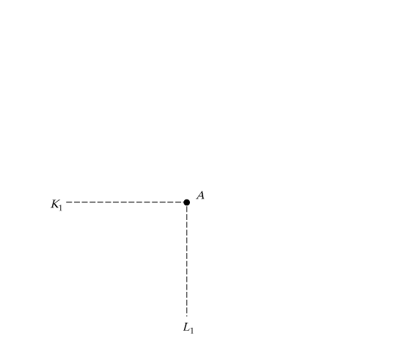
COST IN THE LONG RUN
7.3
The Isocost Line
Figure 7.3
Producing a Given Output at Minimum Cost
Isocost curves describe the combination of inputs to production that cost the same amount to the firm.
Isocost curve C₁ is tangent to isoquant q₁ at A and shows that output q₁ can be produced at minimum cost with labor input L₁ and capital input K₁.
Other input combinations-L₂, K₂ and L₃, K₃-yield the same output but at higher cost.

Slide 22

COST IN THE LONG RUN
7.3
The Isocost Line
If we rewrite the total cost equation as an equation for a straight line, we get
It follows that the isocost line has a slope of ΔK/ΔL = −(w/r), which is the ratio of the wage rate to the rental cost of capital.

Slide 23
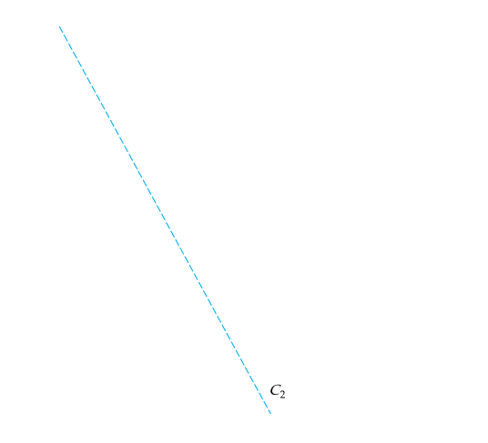
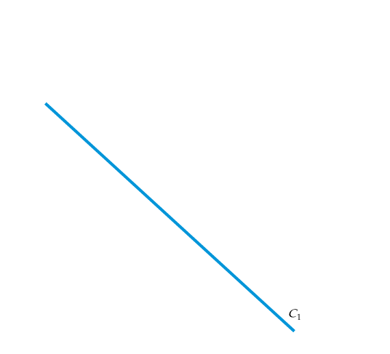
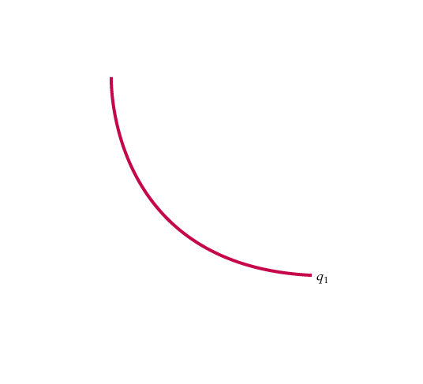
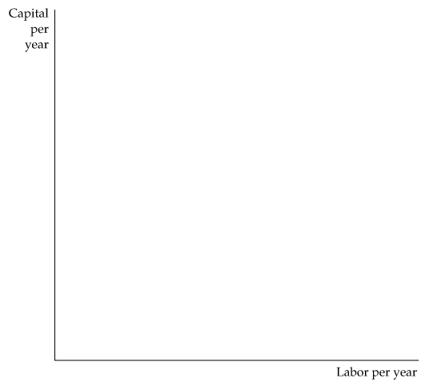
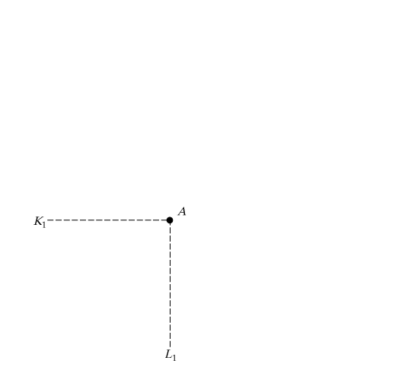
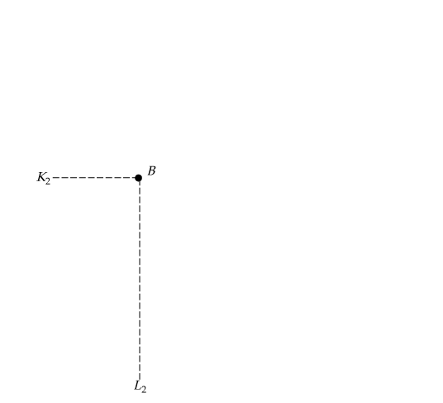
COST IN THE LONG RUN
7.3
Choosing Inputs
Figure 7.4
Input Substitution When an Input Price Changes
Facing an isocost curve C₁, the firm produces output q₁ at point A using L₁ units of labor and K₁ units of capital.
When the price of labor increases, the isocost curves become steeper.
Output q₁ is now produced at point B on isocost curve C₂ by using L₂ units of labor and K₂ units of capital.

Slide 24



COST IN THE LONG RUN
7.3
Choosing Inputs
Recall that in our analysis of production technology, we showed that the marginal rate of technical substitution of labor for capital (MRTS) is the negative of the slope of the isoquant and is equal to the ratio of the marginal products of labor and capital:
(7.3)
It follows that when a firm minimizes the cost of producing a particular output, the following condition holds:
We can rewrite this condition slightly as follows:
(7.4)

Slide 25


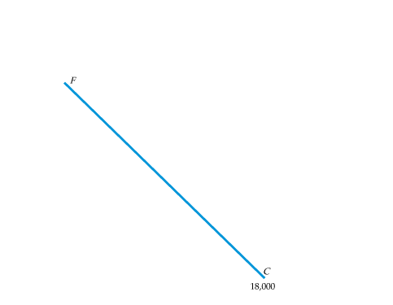
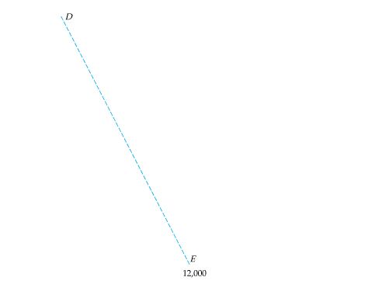
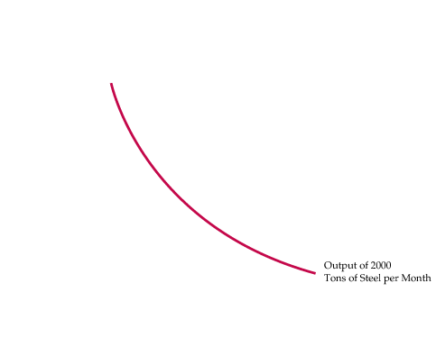
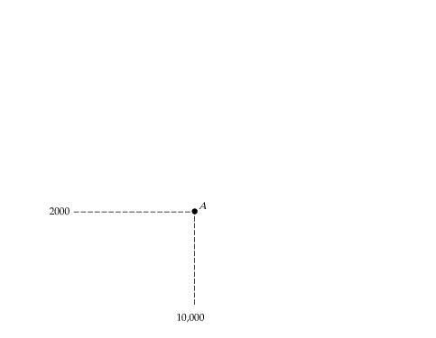
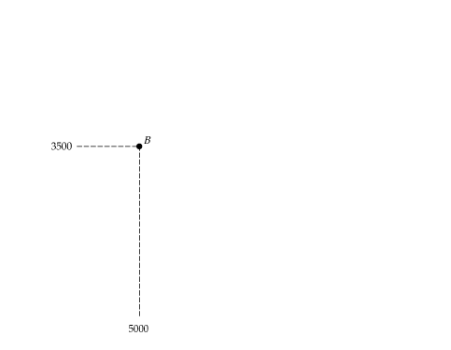
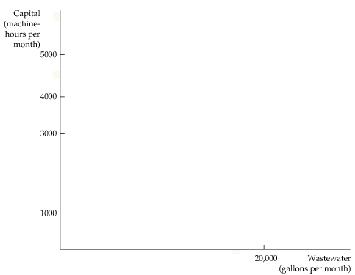
COST IN THE LONG RUN
7.3
Figure 7.5
The Cost-Minimizing Response to an Effluent Fee
When the firm is not charged for dumping its wastewater in a river, it chooses to produce a given output using 10,000 gallons of wastewater and 2000 machine-hours of capital at A.
However, an effluent fee raises the cost of wastewater, shifts the isocost curve from FC to DE, and causes the firm to produce at B—a process that results in much less effluent.

Slide 26
COST IN THE LONG RUN
7.3
Cost Minimization with Varying Output Levels
● expansion path Curve passing through points of tangency between a firm’s isocost lines and its isoquants.
The Expansion Path and Long-Run Costs
To move from the expansion path to the cost curve, we follow three steps:
  Choose an output level represented by an isoquant. Then find the point of tangency of that isoquant with an isocost line.
  From the chosen isocost line determine the minimum cost of producing the output level that has been selected.
  Graph the output-cost combination.

Slide 27
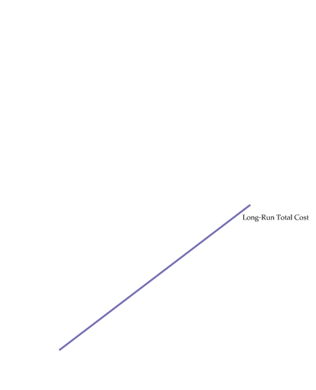
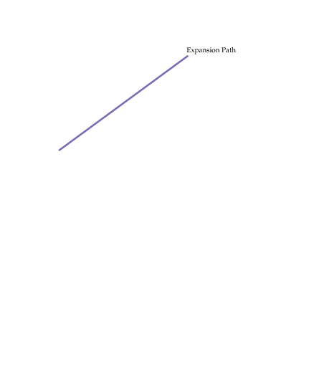
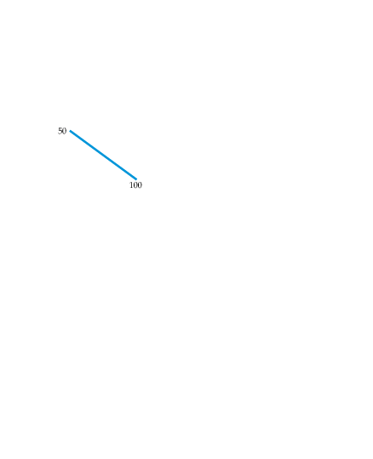

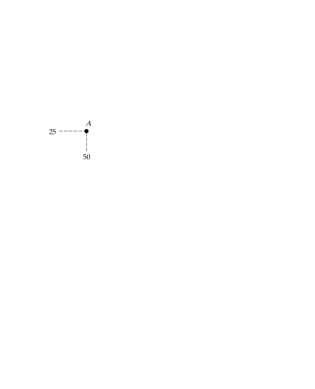
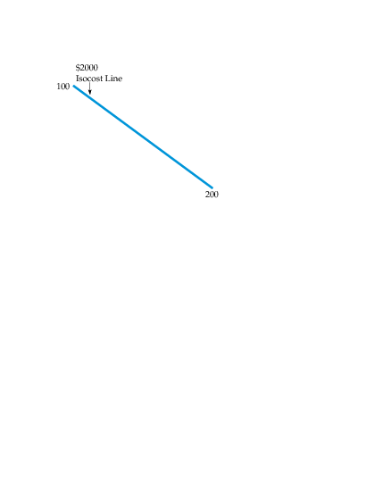
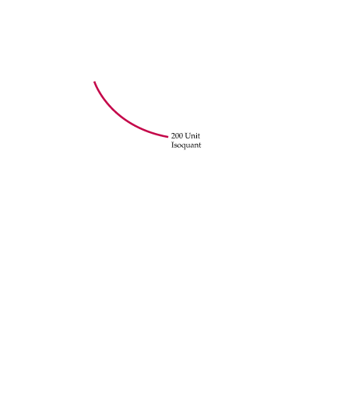
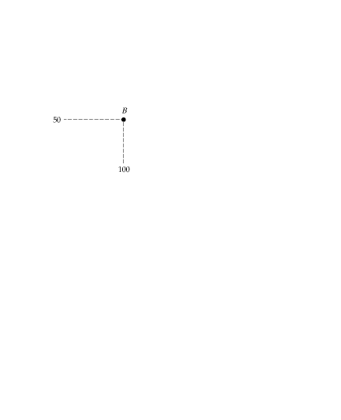
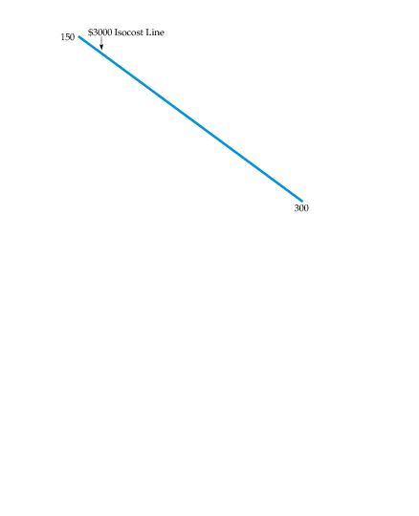
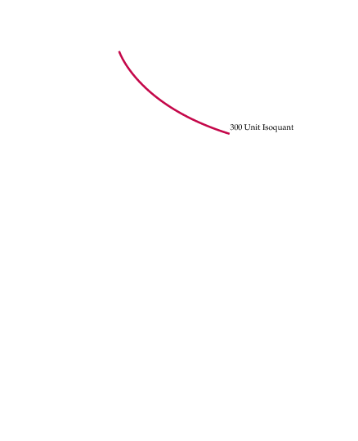
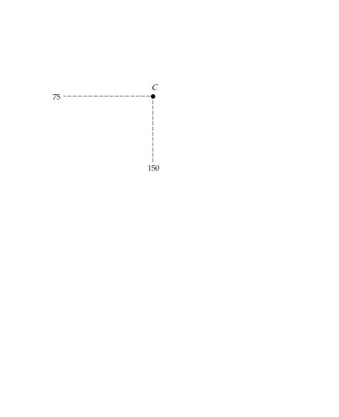
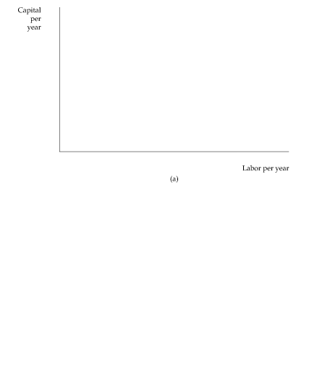
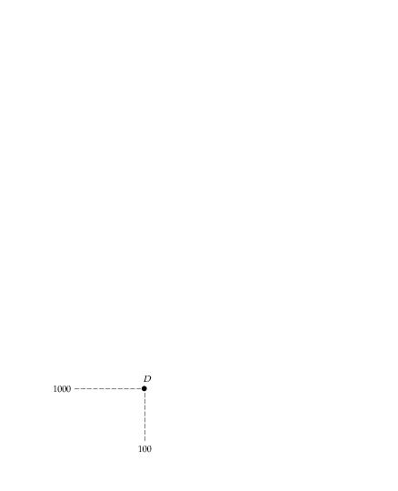



COST IN THE LONG RUN
7.3
Cost Minimization with Varying Output Levels
Figure 7.6
Input Substitution When an Input Price Changes
In (a), the expansion path (from the origin through points A, B, and C) illustrates the lowest-cost combinations of labor and capital that can be used to produce each level of output in the long run— i.e., when both inputs to production can be varied.
In (b), the corresponding long-run total cost curve (from the origin through points D, E, and F) measures the least cost of producing each level of output.

Slide 28











LONG-RUN VERSUS SHORT-RUN COST CURVES
7.4
The Inflexibility of Short-Run Production
Figure 7.7
The Inflexibility of Short-Run Production
When a firm operates in the short run, its cost of production may not be minimized because of inflexibility in the use of capital inputs.
Output is initially at level q₁, (using L₁, K₁).
In the short run, output q₂ can be produced only by increasing labor from L₁ to L₃ because capital is fixed at K₁.
In the long run, the same output can be produced more cheaply by increasing labor from L₁ to L₂ and capital from K₁ to K₂.

Slide 29






LONG-RUN VERSUS SHORT-RUN COST CURVES
7.4
Long-Run Average Cost
Figure 7.8
Long-Run Average and Marginal Cost
When a firm is producing at an output at which the long-run average cost LAC is falling, the long-run marginal cost LMC is less than LAC.
Conversely, when LAC is increasing, LMC is greater than LAC.
The two curves intersect at A, where the LAC curve achieves its minimum.

Slide 30
LONG-RUN VERSUS SHORT-RUN COST CURVES
7.4
Long-Run Average Cost
● long-run average cost curve (LAC) Curve relating average cost of production to output when all inputs, including capital, are variable.
● short-run average cost curve (SAC) Curve relating average cost of production to output when level of capital is fixed.
● long-run marginal cost curve (LMC) Curve showing the change in long-run total cost as output is increased incrementally by 1 unit.

Slide 31
LONG-RUN VERSUS SHORT-RUN COST CURVES
7.4
Economies and Diseconomies of Scale
As output increases, the firm’s average cost of producing that output is likely to decline, at least to a point.
This can happen for the following reasons:
  If the firm operates on a larger scale, workers can specialize in the activities at which they are most productive.
  Scale can provide flexibility. By varying the combination of inputs utilized to produce the firm’s output, managers can organize the production process more effectively.
  The firm may be able to acquire some production inputs at lower cost because it is buying them in large quantities and can therefore negotiate better prices. The mix of inputs might change with the scale of the firm’s operation if managers take advantage of lower-cost inputs.

Slide 32
LONG-RUN VERSUS SHORT-RUN COST CURVES
7.4
Economies and Diseconomies of Scale
At some point, however, it is likely that the average cost of production will begin to increase with output.
There are three reasons for this shift:
  At least in the short run, factory space and machinery may make it more difficult for workers to do their jobs effectively.
  Managing a larger firm may become more complex and inefficient as the number of tasks increases.
  The advantages of buying in bulk may have disappeared once certain quantities are reached. At some point, available supplies of key inputs may be limited, pushing their costs up.

Slide 33
LONG-RUN VERSUS SHORT-RUN COST CURVES
7.4
Economies and Diseconomies of Scale
● economies of scale Situation in which output can be doubled for less than a doubling of cost.
● diseconomies of scale Situation in which a doubling of output requires more than a doubling of cost.
Increasing Returns to Scale: Output more than doubles when the quantities of all inputs are doubled.
Economies of Scale: A doubling of output requires less than a doubling of cost.

Slide 34


LONG-RUN VERSUS SHORT-RUN COST CURVES
7.4
Economies and Diseconomies of Scale
Economies of scale are often measured in terms of a cost-output elasticity, E_{C}. E_{C} is the percentage change in the cost of production resulting from a 1-percent increase in output:
(7.5)
To see how E_{C} relates to our traditional measures of cost, rewrite equation as follows:
(7.6)

Slide 35
















LONG-RUN VERSUS SHORT-RUN COST CURVES
7.4
The Relationship Between Short-Run and Long-Run Cost
Figure 7.9
Long-Run Cost with Economies and Diseconomies of Scale
The long-run average cost curve LAC is the envelope of the short-run average cost curves SAC₁, SAC₂, and SAC₃.
With economies and diseconomies of scale, the minimum points of the short-run average cost curves do not lie on the long-run average cost curve.

Slide 36




PRODUCTION WITH TWO OUTPUTS—
ECONOMIES OF SCOPE
7.5
Product Transformation Curves
Figure 7.10
Product Transformation Curve
The product transformation curve describes the different combinations of two outputs that can be produced with a fixed amount of production inputs.
The product transformation curves O₁ and O₂ are bowed out (or concave) because there are economies of scope in production.
● product transformation curve Curve showing the various combinations of two different outputs (products) that can be produced with a given set of inputs.

Slide 37
PRODUCTION WITH TWO OUTPUTS—
ECONOMIES OF SCOPE
7.5
Economies and Diseconomies of Scope
● economies of scope Situation in which joint output of a single firm is greater than output that could be achieved by two different firms when each produces a single product.
● diseconomies of scope Situation in which joint output of a single firm is less than could be achieved by separate firms when each produces a single product.

Slide 38

PRODUCTION WITH TWO OUTPUTS—
ECONOMIES OF SCOPE
7.5
The Degree of Economies of Scope
To measure the degree to which there are economies of scope, we should ask what percentage of the cost of production is saved when two (or more) products are produced jointly rather than individually.
(7.7)
● degree of economies of scope (SC) Percentage of cost savings resulting when two or more products are produced jointly rather than Individually.

Slide 39


PRODUCTION WITH TWO OUTPUTS—
ECONOMIES OF SCOPE
7.5
  In the trucking business, several related products can be offered, depending on the size of the load and the length of the haul. This range of possibilities raises questions about both economies of scale and economies of scope.
The scale question asks whether large-scale, direct hauls are more profitable than individual hauls by small truckers. The scope question asks whether a large trucking firm enjoys cost advantages in operating direct quick hauls and indirect, slower hauls.
Because large firms carry sufficiently large truckloads, there is usually no advantage to stopping at an intermediate terminal to fill a partial load.
Because other disadvantages are associated with the management of very large firms, the economies of scope get smaller as the firm gets bigger.
The study suggests, therefore, that to compete in the trucking industry, a firm must be large enough to be able to combine loads at intermediate stopping points.

Slide 40
DYNAMIC CHANGES IN COSTS—
THE LEARNING CURVE
7.6
As management and labor gain experience with production, the firm’s marginal and average costs of producing a given level of output fall for four reasons:
  Workers often take longer to accomplish a given task the first few times they do it. As they become more adept, their speed increases.
  Managers learn to schedule the production process more effectively, from the flow of materials to the organization of the manufacturing itself.
  Engineers who are initially cautious in their product designs may gain enough experience to be able to allow for tolerances in design that save costs without increasing defects. Better and more specialized tools and plant organization may also lower cost.
  Suppliers may learn how to process required materials more effectively and pass on some of this advantage in the form of lower costs.

Slide 41


DYNAMIC CHANGES IN COSTS—
THE LEARNING CURVE
7.6
Figure 7.11
The Learning Curve
A firm’s production cost may fall over time as managers and workers become more experienced and more effective at using the available plant and equipment.
The learning curve shows the extent to which hours of labor needed per unit of output fall as the cumulative output increases.
● learning curve Graph relating amount of inputs needed by a firm to produce each unit of output to its cumulative output.

Slide 42











DYNAMIC CHANGES IN COSTS—
THE LEARNING CURVE
7.6
Graphing the Learning Curve
The learning curve is based on the relationship
(7.8)
Learning versus Economies of Scale
Figure 7.12
Economies of Scale versus Learning
A firm’s average cost of production can decline over time because of growth of sales when increasing returns are present (a move from A to B on curve AC₁),
or it can decline because there is a learning curve (a move from A on curve AC₁ to C on curve AC₂).

Slide 43

DYNAMIC CHANGES IN COSTS—
THE LEARNING CURVE
7.6
Learning versus Economies of Scale
TABLE 7.3
Predicting the Labor Requirements of Producing
a Given Output
Cumulative Output Per-Unit Labor Requirement Total Labor
(N) for Each 10 Units of Output (L)* Requirement
10 1.00 10.0
20 .80 18.0(10.0 + 8.0)
30 .70 25.0(18.0 + 7.0)
40 .64 31.4(25.0 + 6.4)
50 .60 37.4(31.4 + 6.0)
60 .56 43.0(37.4 + 5.6)
70 .53 48.3(43.0 + 5.3)
80 .51 53.4(48.3 + 5.1)
*The numbers in this column were calculated from the equation log(L) = −0.322 log(N/10), where L is the
unit labor input and N is cumulative output.

Slide 44





DYNAMIC CHANGES IN COSTS—
THE LEARNING CURVE
7.6
Figure 7.13
Learning Curve for Airbus Industrie
The learning curve relates the labor requirement per aircraft to the cumulative number of aircraft produced.
As the production process becomes better organized and workers gain familiarity with their jobs, labor requirements fall dramatically.

Slide 45



ESTIMATING AND PREDICTING COST
7.7
● cost function Function relating cost of production to level of output and other variables that the firm can control.
Figure 7.14
Variable Cost Curve for the Automobile Industry
An empirical estimate of the variable cost curve can be obtained by using data for individual firms in an industry.
The variable cost curve for automobile production is obtained by determining statistically the curve that best fits the points that relate the output of each firm to the firm’s variable cost of production.

Slide 46



ESTIMATING AND PREDICTING COST
7.7
To predict cost accurately, we must determine the underlying
relationship between variable cost and output. The curve provides a reasonably close fit to the cost data.
But what shape is the most appropriate, and how do we represent that shape algebraically?
Here is one cost function that we might choose:
(7.9)
If we wish to allow for a U-shaped average cost curve and a marginal cost that is not constant, we must use a more complex cost function. One possibility is the quadratic cost function, which relates variable cost to output and output squared:
(7.10)
If the marginal cost curve is not linear, we might use a cubic cost function:
(7.11)

Slide 47




ESTIMATING AND PREDICTING COST
7.7
Figure 7.15
Cubic Cost Function
A cubic cost function implies that the average and the marginal cost curves are U-shaped.

Slide 48

ESTIMATING AND PREDICTING COST
7.7
Cost Functions and the Measurement of Scale Economies
The scale economies index (SCI) provides an index of whether or not there are scale economies.
SCI is defined as follows:
(7.12)

Slide 49


ESTIMATING AND PREDICTING COST
7.7
  In 1955, consumers bought 369 billion kilowatt- hours (kwh) of electricity; in 1970 they bought 1083 billion.
Was this increase due to economies of scale or to other factors?
If it was the result of economies of scale, it would be economically inefficient for regulators to “break up” electric utility monopolies.
TABLE 7.4
Scale Economies in the Electric Power Industry
Output (million kwh) 43 338 1109 2226 5819
Value of SCI, 1955 .41 .26 .16 .10 .04

Slide 50





ESTIMATING AND PREDICTING COST
7.7
Figure 7.16
Average Cost of Production in the Electric Power Industry
The average cost of electric power in 1955 achieved a minimum at approximately 20 billion kilowatt-hours.
By 1970 the average cost of production had fallen sharply and achieved a minimum at an output of more than 33 billion kilowatt-hours.

